Slide 1



IN THE NAME OF GOD
DARK WEB
Professer:Zahra Sadat
Presenter:Mohammad Reza Gholami
December 20

Slide 2
((Subjects))
1-What Is Dark Web
2-How To Access It
3-Content Of Dark Web
1/8

Slide 3
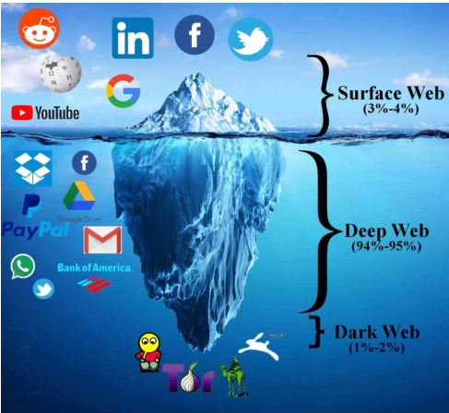
((Part Of Internet))
2/8

Slide 4

((What Is Dark Web))
3/8

Slide 5

((How To Access It))
4/8

Slide 6
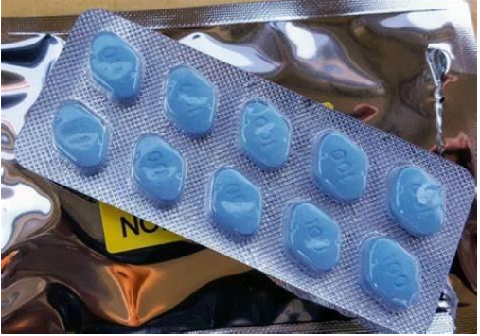
((Drugs And Medicine))
5/8

Slide 7
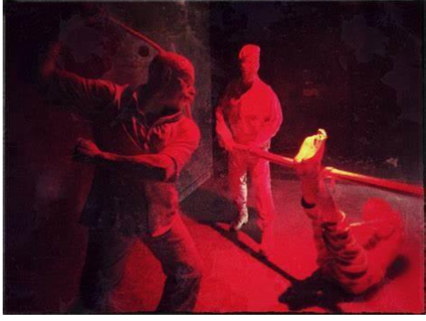
((Red Room))
6/8

Slide 8

((Bitcoin))
7/8

Slide 9
((منابع))
1-Wikipedia.com
2-Zoomit.ir
3-Icfied.ir
8/8

Slide 10
((Thank For Your Attention))
((Good Luck))

